Slide 1
Discussion of Emergency Mental
Health Resources and Court Orders
Presented by Shawni Miller, MSW,LCSW Emergency Services Supervisor
Community Counseling Center.

Slide 2

Objectives
Geographic Statistics of Suicide/Mental Health Services in the community.
Define mental disorder, likelihood of serious harm to self or to others.
Review liability for health care professionals, public officials and peace officers.
Civil Commitment Laws and Definitions
Involuntary Court Order Implementation and Documents.
Emergency Mental Health Community Training/Resources available.
Discuss what comprises a legally sound affidavit.

Slide 3
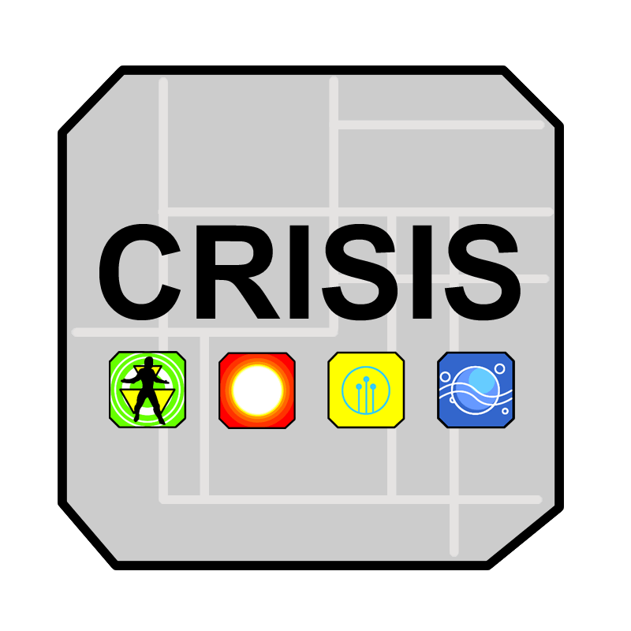
Emergency Services provided by Community Counseling Center
Daytime Walk-In Crisis Services
MOCARS 24 hours crisis Line
MOCARS follow-Up
24 Hour Crisis Response to hospitals, Jail, residential facilities, etc.
Crisis Risk Assessment
Obtain hospital placement
Complete court order if needed
Referrals for outpatient Services/ Safety Plan

Slide 4
Emergency Services provided by Community Counseling Center
Crisis Intervention involves outreach services for individuals who are at risk of harming themselves or others. Community Counseling Center with the Department of Mental Health (DMH) provides the 800 Crisis Line through a regional contract between DMH and the Behavioral Health Response (BHR) team in St. Louis, MO. The system involves emergency calls to be screened by BHR which forwards callers' information to CCC's on-call crisis team. These professionals respond to individuals in crisis with face-to-face interventions at clinic locations, in hospital emergency rooms, at jails, or at other safe locations in the communities that we serve. CCC provides these services to anyone in our catchment area, 24 hours a day, 7 days a week.

Slide 5
Risk Assessment
1. Assess risk factors
2. Suicide Inquiry: thoughts/plan /intent/access to means
3. Assess protective factors
4. Clinical judgment
5. Document/screening tools

Slide 6
Clinical Screening
Assessment that identifies:
Suicidal/Homicidal Ideations, plans, means, intent, history, triggers. Mental health symptoms, psychosis, depression/anxiety etc. and self care.
History of mental health, substance use, medical conditions, medications/compliance.
Current supports, living environment, employment/education, legal, recent loss.

Slide 7
Intervention
Inpatient Hospitalization
Safety planning (identify warning signs, coping skills, supports, and removes assess to means, next day appointment/phone call)
Outpatient Services and Follow up (follow up phone call, establish outpatient services, provide Mocars crisis line)
Community mental health liaison- Warren Skinner

Slide 8

Geographic Statistics of Suicide/ Comprehensive Psychiatric Services provided in the community
Community Counseling Center serves five counties in Southeast Missouri to include; Cape Girardeau, Perry, Ste. Genevieve, Madison, and Bollinger.
The Department of Mental Health records this data for all Missouri counties including service numbers and number of suicides per county.

Slide 9

Criteria For Hospitalization
Suicidal Ideation (risk of harm to self)
Homicidal Ideation (risk of harm to others0
Psychotic features (hallucinations, delusions)

Slide 10
Risk of Harm to Self
A substantial risk that serious physical harm will be inflicted by a person upon his own person, as evidenced by recent threats, including verbal threats, or attempts to commit suicide or inflict physical harm on himself. Evidence of substantial risk may also include information about patterns of behavior that historically have resulted in serious harm previously being inflicted by a person upon himself.

Slide 11
Risk of Harm to Others
A substantial risk that serious physical harm will be inflicted by a person upon another as evidenced by recent overt acts, behavior or threats, including verbal threats, which have caused such harm or which would place a reasonable person in reasonable fear of sustaining such harm.;

Slide 12

Michaela Wexler, psychiatrist at Nevada Regional Medical Center in Nevada, MO states:
“Ninety-six hour holds save lives. It creates a climate of increasing access to mutual health care and that it is okay to intervene in a situation where someone is not acting in a safe way.”

Slide 13
What is a Court Order?
Commonly Referred to as: 96 hour commitment, civil commitment, involuntary court order
Definition: a legal process to court order someone for psychiatric treatment

Slide 14
Civil Commitment Laws cont.
When JFK signed laws for deinstitutionalization came the legal standard for civil commitments- a dangerous model grave disability or threat to himself or others suicidal/homicidal.
Parent of the Country- Government responsibility to intervene and act its citizens best interest.
Police Power- Protect Citizens

Slide 15
Civil Commitment Laws
Civil commitment laws exist to improve the well being of those whose untreated symptoms pose a threat to their own well being and promote the safety of the public.
A person who presents a likelihood of serious harm to self or others as the result of a mental disorder or alcohol or drug abuse may be involuntarily detained for evaluation and treatment at a mental health or alcohol/drug abuse facility recognized by the department of mental health.

Slide 16
Civil Commitment Definitions
Grave Disability: A condition where a person as a result of a mental illness is in danger of physical harm arising from such complete neglect of basic needs.
Need for treatment: Mental illness prevents him/her from seeking services on a voluntary basis.
Dangerousness: likelihood to intentionally cause serious physical harm to oneself or others.
Non-malevolence- means to do no harm.
Beneficence- Beneficence is action that is done for the benefit of others. Beneficent actions can be taken to help prevent or remove harms or to simply improve the situation of others.

Slide 17
Civil Commitment Definitions cont.
As health professionals we battle the challenge of obligation of non-malevolence and beneficence in deciding whether to involuntary commit someone, if perception of reality is distorted without the capacity to make decisions, then the individual is not truly autonomous, and can be over rid.
The lack of hospital beds to available to all who fall under the state criteria forces the system to triage: This provides beds to those in imminent risk to commit violence against self or others as more in need of the beds.
Discussion…

Slide 18
Liability
Liability
632.440. No officer of a public or private agency, mental health facility or mental health program; no head, attending staff or consultant of any such agency, facility or mental health program; no mental health coordinator, registered professional nurse, licensed physician, mental health professional, etc.. no peace officer responsible for detaining a person pursuant to this chapter

Slide 19
Liability, cont.
regardless of whether such peace officer is outside the jurisdiction for which he serves as a peace officer during the course of such detention or transportation, or both, shall be civilly liable for investigating, detaining, transporting, conditionally releasing or discharging a person pursuant to this chapter or chapter 475, at or before the end of the period for which the person was admitted or detained for evaluation or treatment so long as such duties were performed in good faith and without gross negligence.

Slide 20
Duty To Warn
Tarasoff v. Regents of the University of California
The Supreme Court of California agreed and held that “when a psychotherapist determines or should determine that a patient poses a serious danger of violence to a third party, the psychotherapist has the duty to take reasonable steps to protect that endangered third party”.

Slide 21
Involuntary Implementation and Process
Probate Court Commitment 96 hour Imminent Harm Admission to Mental Health/Alcohol & Drug Abuse Facility based Civil – any adult person can file a petition and the judge signs off.
No liability for petitioners of civil order if application was made in good faith.
In every state, a law enforcement officer is empowered to detain an individual and remove him/her to an evaluation facility if the officer finds probable cause to believe the person may be in need of commitment or if an empowered mental health professional has directed the officer to do so. All states allow this without a court order and most states allow 48-72 hours for evaluation to be completed. (DMH Section 632.305.1)

Slide 22
Involuntary Implementation and Process
96 hour steps: File application, complete affidavits (notarized), a list of witnesses (who complete affidavits). If approved the court will issue an order and warrant directing law enforcement to take person into custody and transport to facility.

Slide 23
Involuntary Implementation Documents
To be completed by the Petitioner
DMH 128 Application
DMH 142 Affidavit
DMH 137 List of Witnesses
To be issued by the Court:
DMH 129 or OSCA MH15 Order for 96 Hour Detention
DMH 130 Warrant

Slide 24
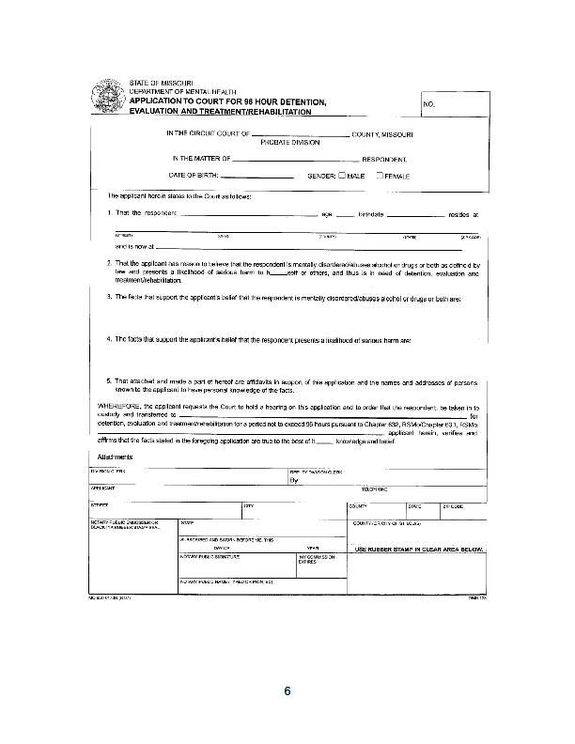
DMH 128 Application

Slide 25
Keep in Mind…
Suicide Risk is highest following discharge from psychiatric inpatient or ED settings.
Studies have shown a decrease in suicide risk from follow up contact after inpatient or ED setting.

Slide 26
DMH 142 Affidavit
Affidavit Basics
DMH 142 is the Affidavit used for mental health and alcohol and drug involuntary commitments and is executed under oath.
“RESPONDENT” means the person who is the subject of the involuntary detention proceedings.
Begin your Affidavit by identifying your relationship to the respondent.
An Affidavit should address issues of mental disorder or alcohol/drug abuse and likelihood of serious harm

Slide 27
DMH 142 Affidavit
Affidavit Basics (Contd.)
Generally, an Affidavit should answer the questions: who, what, when, where, and how.
Describe those behaviors and statements which suggest the person may be mentally disordered or an alcohol and/or drug abuser.
Describe those behaviors and statements that suggest the person may be harmful to himself or others.
Statements should be concise and to the point.
Witnessed behaviors should be included if possible.

Slide 28
DMH 142 Affidavit
Affidavit Basics (Contd.)
Peace Officer Affidavits are based on the officer’s own personal observations or investigations.
Write only on the front of the Affidavit form.
Affidavits must be notarized.
The Affidavit becomes part of the court file and medical record which are accessible to the individual if the individual requests to see it. There is no guarantee of confidentiality.
Some probate courts may require more than one Affidavit in certain situations or may have other or additional requirements.

Slide 29
DMH 142 Affidavit
Affidavit Form DMH-142
Respondent Name
Witness Name
Facts/Behaviors observed
Signature
Notary

Slide 30
DMH 142 Affidavit
Affidavits- address issues of mental health harm. It answers who, what, when, where, and how. Describes these behaviors and statements that suggests the person may be harmful
Example: Client reported to this Counselor that he has thoughts of suicide by firearm, states if “I’m is going to do it, it will be in front of others.” Client also states if he completes suicide he is having thoughts to kill others before he takes his own life. Client reports increased depression, poor sleep, and poor appetite due to a recent breakup. Client also has a history of alcohol abuse, reporting he drinks a 12 pack a day. States when detoxing he has black outs and becomes physically aggressive. Client reports he is scared of what he may do. Due to client’s thoughts of suicide and homicide he may be a risk of harm to himself or others.

Slide 31
DMH 142 Affidavit
Affidavit Writing
As a class let’s write a quick statement for this situation:
A local motel calls about a disturbance in a room. When you arrive you see a man at the room wearing a heavy coat, but it is summer.
You enter the room and see the tv is broken. There are two empty pill bottles on the counter. Respondent states he doesn’t know what happened, he indicates he turned the tv off because the motel owner had been watching him through it.
Respondent thanked you for being able to hear his thoughts when he needed you. Respondent asked you to give him a ride to the Emerson Bridge. He has tried to jump from this bridge before.

Slide 32
Case Study
29 year old female reports an increase in depression for the last 2 weeks related to family and financial stress. Client reports a decrease in appetite and poor sleep. Client reports passive suicidal thoughts presently however reports previous night she injected air into her vein, as an attempt of suicide however has a history of attempting this several times in the last month. Client has a history of cutting, last time a week ago, and past attempt of overdose 2 years ago. Client has had multiple past hospitalizations, most recent 2 weeks ago. Client denies substance abuse. Client lives alone. Client reports sees a psychiatrist, therapist, and case manager. Client reports her friends are supports. Client reports she is on disability. Client reports occasional auditory/visual hallucinations, last time a week ago, and her mood presents as calm, affect and speech are appropriate. Client does not want to go to the hospital however is not confident that she can keep herself safe. However client is willing to safety plan including taking away access to self harm.
Do you court order?

Slide 33
Case Study
23 year old female reports yesterday morning, client went to husband’s home and saw another woman there and argued with husband and tried to fight the woman, and impulsively grabbed a kitchen knife and stabbed herself in the chest, husband then brought her to the ER. Client has been medically cleared however, required wounds were substantial. Client reports her and her husband have been separated since May and have a 2 year old son. Client reports depression since the separation and poor sleep. Client denies any SI at this time, reports she regrets doing it. Client reports she broke down and impulsively stabbed herself. Client states she was aiming for her heart but her husband interfered and missed. Client denies past attempts. Client reports SI off and on during the separation, denies a plan. Client reports self harm by cutting, in front of her husband, the day of their separation to “get him to see how he’s hurting me.”, no cutting since then. Client denies HI at this time. Client refuses inpatient, states she is okay now. Do you court order?

Slide 34
Training Resources
Assessing and Managing Suicide Risk (AMSR)
Question, Persuade, Respond (QPR)
Community Counseling Center Suicide Conference
Mental Health First Aid

Slide 35
Questions…
Thank You!
Shawni Miller, MSW, LCSW
Emergency Services Supervisor
Community Counseling Center
sdmiller@cccntr.com
573-382-9658

Slide 36
References
  Harrison. K. Springfield News-Leader, “Psychiatrist: 96 hour holds save lives”, Feb, 2015
  B. Stettin, J. Geler, K. Ragosta, K. Cohen, J. Ghourwal; “Mental health commitment laws, a survey of the states”, Treatment Advocacy Center, Feb. 2014, p. 7, 16, 18, 28.
  M. Testa, S. West, Psychiatry (Edgmat), 2010 Octo, 7/10, p. 30-40.
  dmh.mo.gov/docs/mentalillness/refguidecidforms.pdf
  Community Counseling Center, Mocars Data, for North and South Counties of Emergency Services.
  Missouri Revised Statutes: http://www.moga.mo.gov
  /mostatutes/ChaptersIndex/chaptIndex632.html

