Slide 1
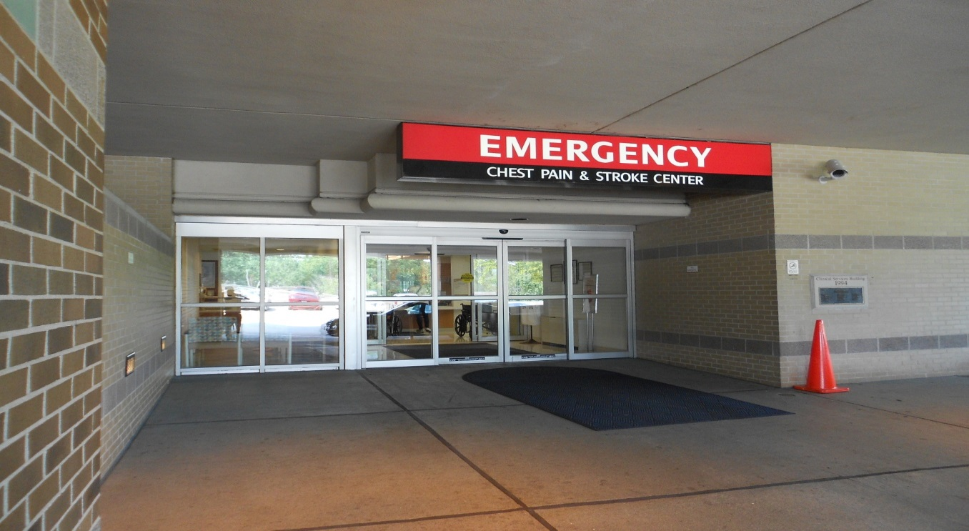
Emergency Departments AND Crisis Intervention
“From the Hospital Perspective”
Presented by:
Linda G. Brown MSN, APRN, BC, FNP-C
Director, Emergency Services
Southeast Hospital
Cape Girardeau

Slide 2
“From the Hospital Perspective”
Presented by:
Linda G. Brown MSN, APRN, BC, FNP-C
Director, Emergency Services
Southeast Hospital
Cape Girardeau

Slide 3
Objectives:
List phone numbers and persons to contact before arrival at the hospital.
Identify where to enter the Hospital
Identify where to take the individual/patient once inside the Hospital
Verbalize understanding of the hospital’s requirements, rules and regulations:
EMTALA, HIPPA, Paperwork (specifically- Affidavits)
Describe what information the hospital is authorized to release to the law enforcement.

Slide 4
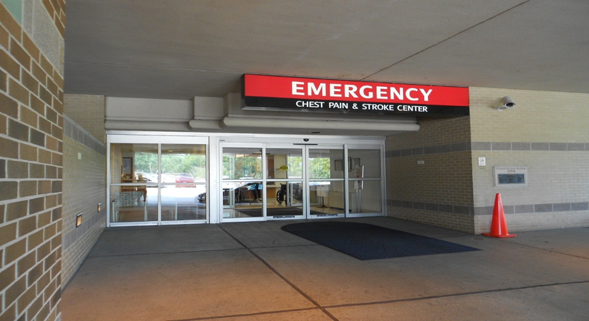
First Contact with ED
List phone numbers and persons to contact before arrival at the Cape hospital(s).
Southeast Emergency Department
573-651-5555.
Saint Francis Emergency Department
573-331-3000
Identify Self/Department/Service and ask for the Charge Nurse.
“Charge Nurse” - coverage 24/7
Notes:
Emergency Department – 651-5555.
Identify Self/Department/Service and ask for the Charge Nurse.
“Charge Nurse” - coverage 24/7
At Southeast Hospital: Enter the Emergency Department Ambulance Entrance
Based on discussion with Charge Nurse,
Generally will be met at the Ambulance Entrance and escorted directly to patient room with registration done at the “Bed Side”.
May be directed to go to the ED Registration Desk and Triage.

Slide 5
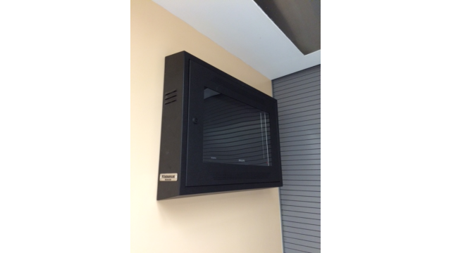
Identify where to take the individual/patient once inside the Hospital
Notes:
The ED Behavioral Health Volume is currently 8% of total ED YTD Volume. Monthly Averages 2017: ED BH registrations: 245/mo. Admitted to SE BH Unit: 40/mo. Admitted to SE Medical Units for stabilization: 42/mo. Transfer to other psych facilities: 37/month (One third is involuntary) We have treat and release with planned follow up: 125-130/month.

Slide 6
Behavioral Health Arrival Times 2017

Slide 7
Background: The Medical Profession’s Duty to Provide “Charity Care”
Physicians have a professional duty to treat the sick, regardless of their ability to pay.
Government stepped in: Hospitals built under the Hill-Burton Act (1946) where obliged to offer emergency treatment to those unable to pay. Cost was offset by federal (tax) dollars.
EMTALA, enacted in 1986, extended that obligation to all hospitals that participate in Medicare Programs.
Purpose: to provide an “adequate first response to a medical crisis for all patients.”
Notes:
The earliest US “hospitals” were poor houses run by charities.
With the development of modern health care and formal payment for services by insurance companies, people who did not have insurance and could not pay were sent to “Charity” hospitals.

Slide 8
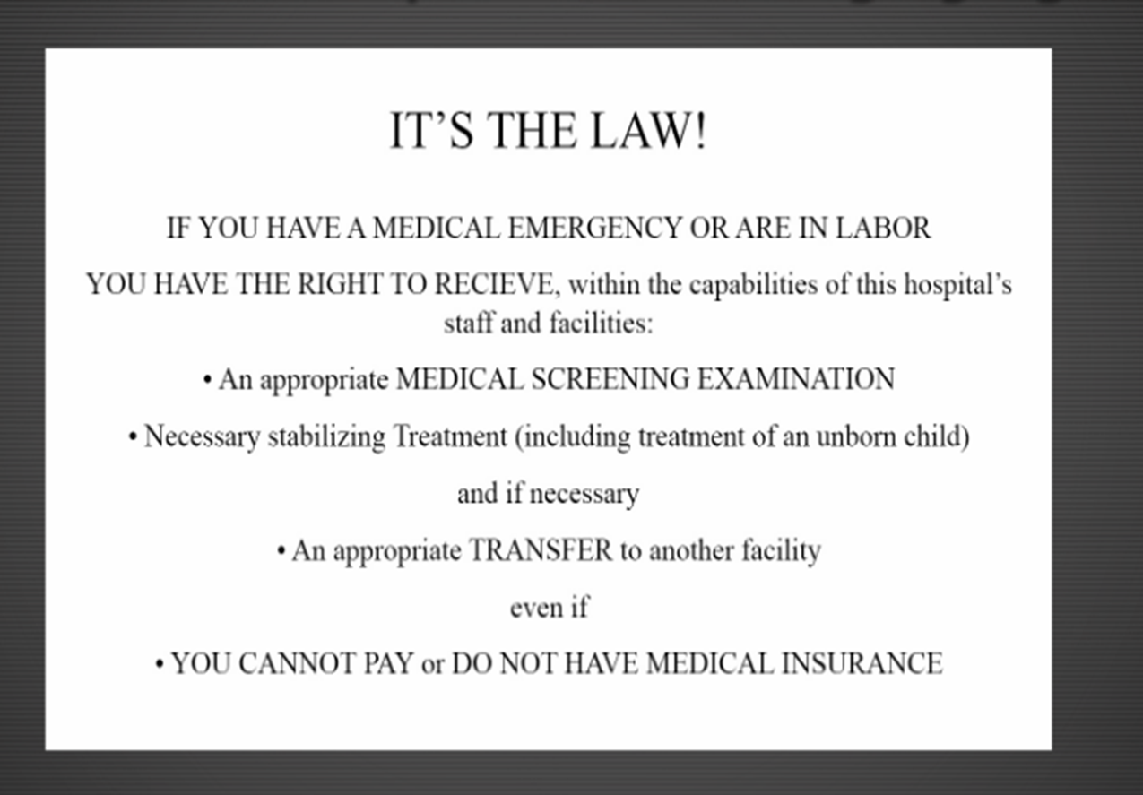
Notes:
A federal law enacted by congress in 1986
AKA the Anti-Dumping Law or Statute, and COBRA (the Consolidated Omnibus Budget and Reconciliation act
Assures that any person that comes to the hospital for treatment of an emergency medical condition is provided a Medical Screening Examination
Stabilization Treatment if an emergency medical condition exists and/or appropriate transfer if the hospital does not have the capability or capacity
No person may be denied care or transferred to another facility based on their ability to pay
“Emergency Medical Condition”

Slide 9
EMTALA ! Emergency Medical Treatment and Active Labor Act
A federal law enacted by congress in 1986
AKA the Anti-Dumping Law or Statute, and COBRA (the Consolidated Omnibus Budget and Reconciliation act
Assures that any person that comes to the hospital for treatment of an emergency medical condition is provided a Medical Screening Examination
Stabilization Treatment (if an emergency medical condition exists) and/or appropriate transfer if the hospital does not have the capability or capacity
No person may be denied care or transferred to another facility based on their ability to pay
“Emergency Medical Condition”

Slide 10
EMTALA (Emergency Medical Treatment and Active Labor Act)
EMTALA Applies to any person who seeks emergency care, whether they enter the hospital through the ER, Main Lobby, any other department of the main hospital or the main hospital campus (within 50 feet of the property of the main campus of the hospital)

Slide 11
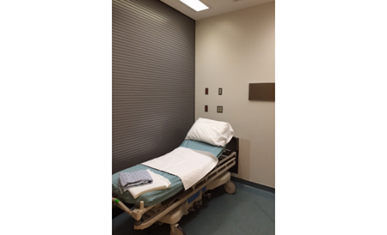
Emergency Medical Condition:
A medical condition with acute symptoms of sufficient severity including:
Severe pain,
psychiatric disturbances,
symptoms of substance abuse,
The absence of immediate medical attention could reasonably result in the following:
Placing the health of an individual in serious jeopardy
Serious Impairment to bodily functions or dysfunction of an organ or body part
Or serious physical harm to self or to others, including ideation of suicide, homicide or other acts of intentional harm to self or to others.

Slide 12
What does the Emergency Department do to determine if an “Emergency Medical Condition” Exists?
Emergency Medical Screening Examination

Slide 13
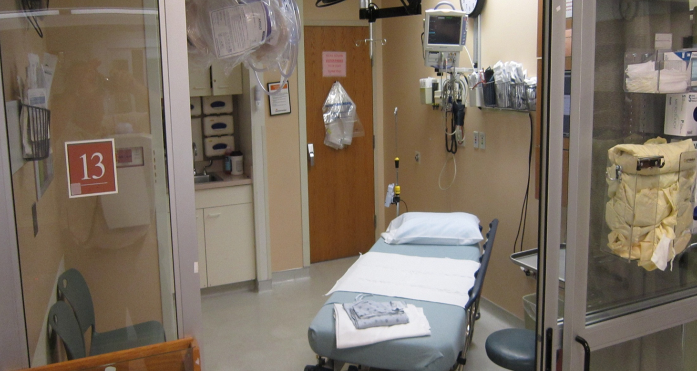
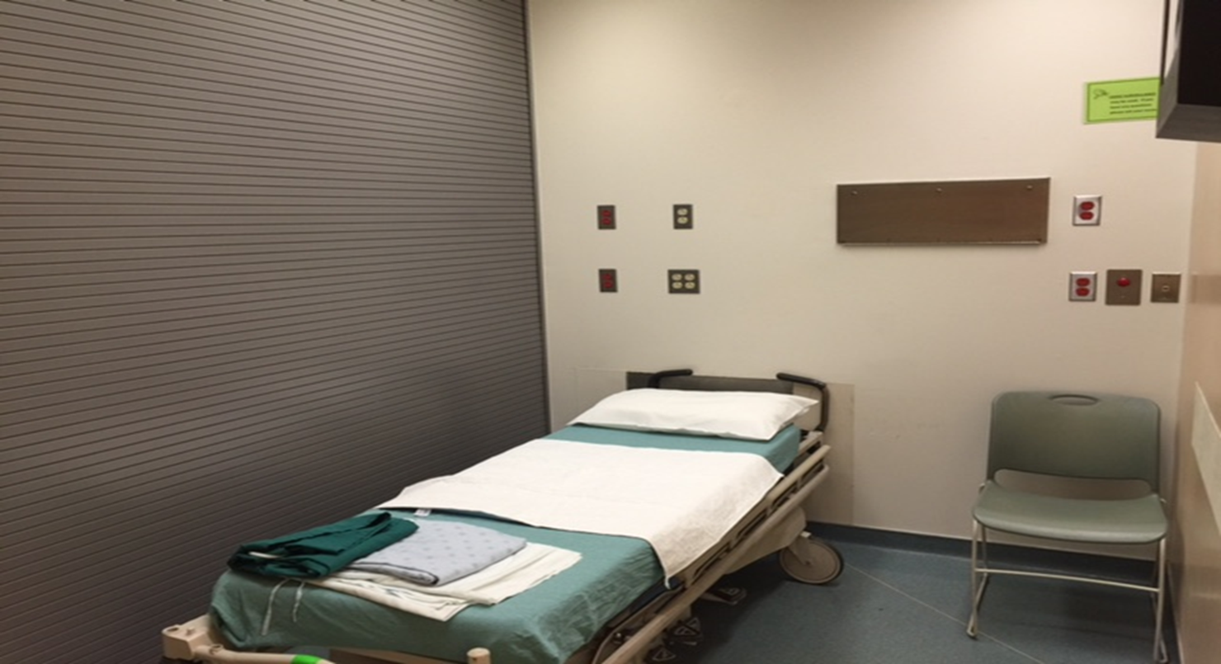
Behavioral Health Patient Intake/Assessment Process (SE Hospital)
Triage – Rapidly assess for life or limb threatening condition or illness by Nurse. If arrived by EMS or Law Enforcement patient may be escorted straight to room and Triage performed at bedside.
Take patient to psych safe room that is appropriate for the patient’s condition
Notes:
Not all emergency departments are prepared with pre-designated psych safe rooms. Assist the staff in identifying potentially harmful items that are in treatment rooms that could be used by the patient to harm self or others.

Slide 14
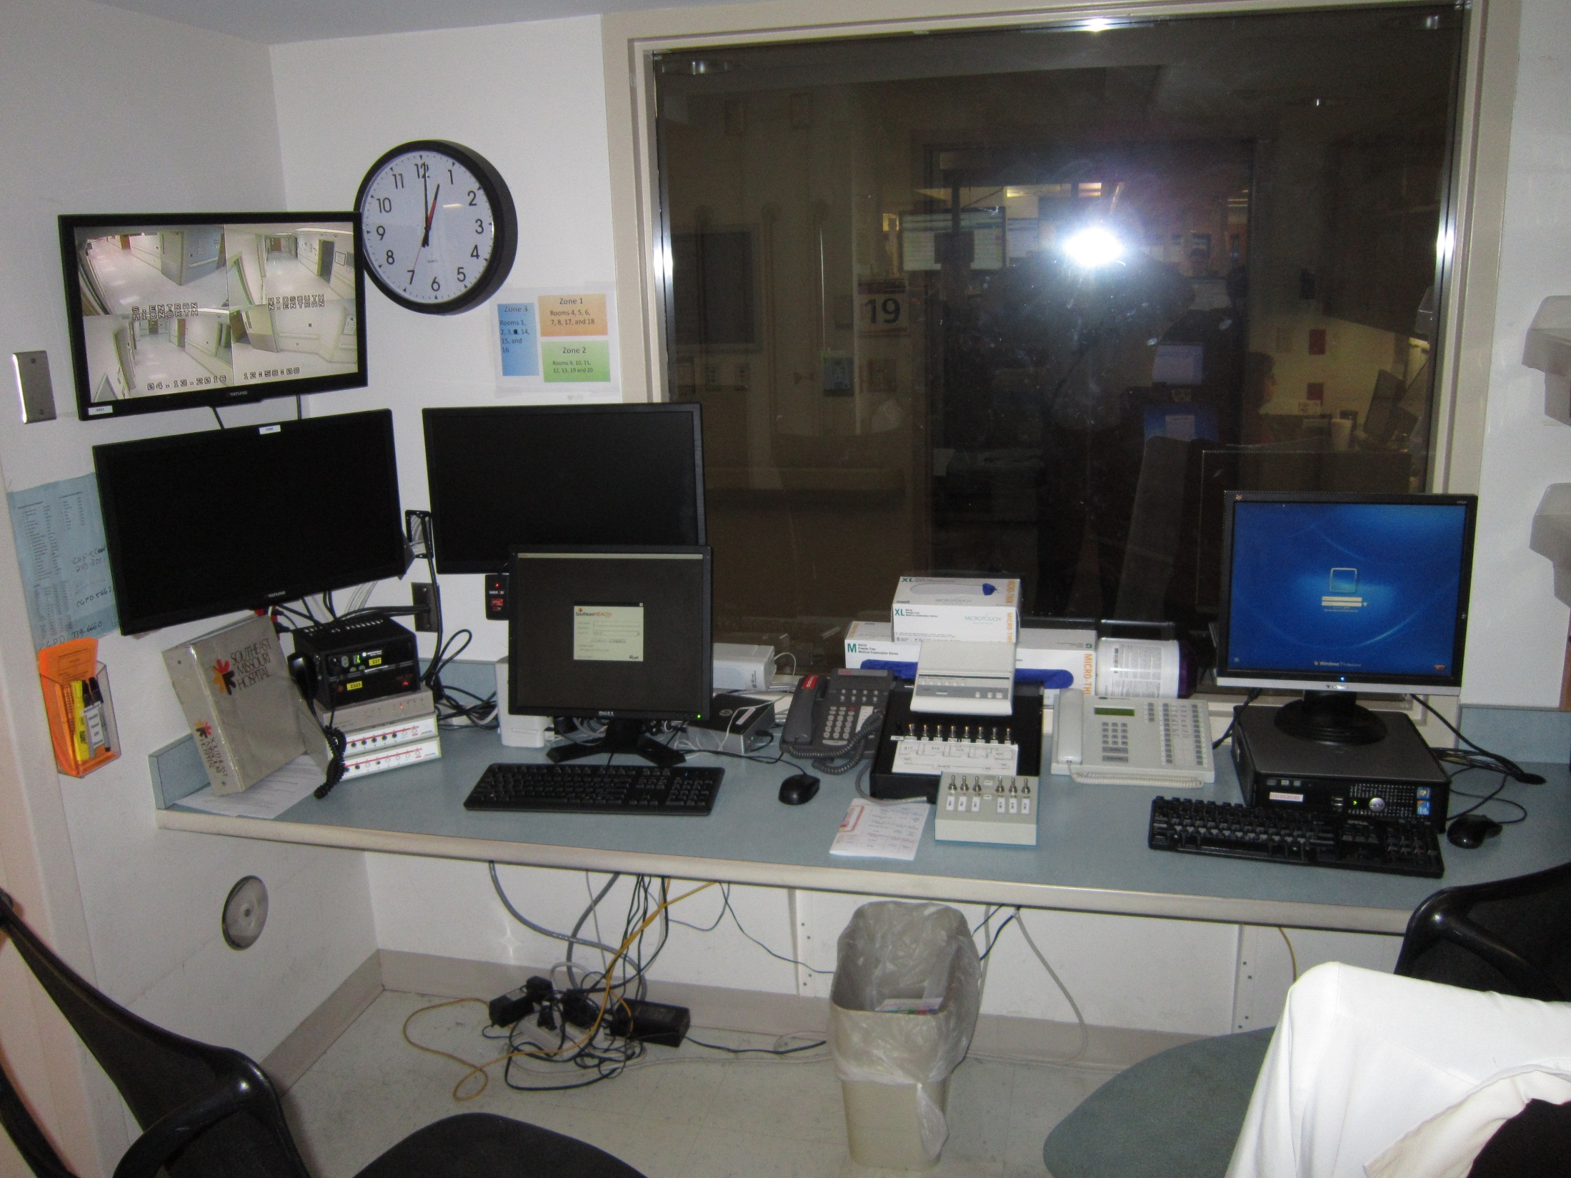
Behavioral Health Patient Intake/Assessment Process (SE Hospital)
BH patient’s are designated a Behavioral Health
Status in the ED of “Monitored” or “Close Observation”.
They are disrobed and placed in an appropriate gown.
Those on Close Observation are searched for contraband or prohibited items.
They are then placed in a specific BH gown or scrubs. (Green)
Video Monitoring is initiated by Security.
Patients are monitored remotely. (Security
Station inside ED Center Court area)
Security is provided with a “Hand-off communication” card (the orange card) that indicates the chief complaint and the level of observation required for the individual.

Slide 15
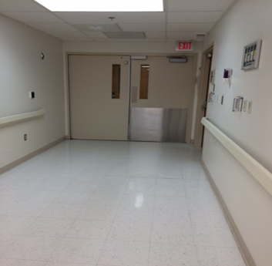
Behavioral Health Patient Intake/Assessment Process (SE Hospital)
Primary Nurse completes initial assessment.
Notifies Physician of patients arrival.
(If greater than 15 minutes for physician to see patient,
Primary Nurse initiates BH lab work (blood work and urine).
ED Physician performs physical examination of patient.
Places “order”/request for Social Worker Psychiatric Evaluation.
ED Physician evaluates results of diagnostic tests. Makes determination if patient is medically stable, then makes disposition/decision.
If patient is not medically stable, patient will be admitted to inpatient medical unit and further psychological evaluation will occur later in the admission.

Slide 16
Behavioral Health Patient Intake/Assessment Process (SE Hospital)
Psychiatric Evaluation will screen for:
Physical and mental illness (including delusions, hallucinations, impaired reality testing)
History of violence to self or others
Suicide attempt or voiced suicidal ideation
Lacerations or other self-inflicted injury
Danger to self or others by making violent acts, gestures or threats
Severe agitation
Signs of confusion or mental status changes
Grave passive neglect of “grave disability”
Substance intoxication or withdrawal that can affect the patient’s cognition or judgment
Decreased consciousness suggestive of drug overdose or head injury
Signs of confusion for which a reason cannot be determined.
NOTE: A psychiatric emergency medical condition is considered “stable” when
the patient is no longer a threat to self or others. They can be considered
“stable for transfer” when they are protected from harming self or others.
Notes:
They may still be suidical and certainly still possessing acute psychiatric symptoms, but should be rendered safe either by self control, medication or restraint, to go into an ambulance or law enforcement vehicle without causing harm to self or others.

Slide 17
Behavioral Health Patient Intake/Assessment Process (SE Hospital)
Social Worker talks to ED staff/physician/family (EMS/Law Enforcement, if available) and then interviews patient and performs initial psychosocial assessment at the patients bedside.
Social Worker contacts psychiatrist to discuss findings of behavioral health evaluation and Psychiatrist recommendation for disposition (admit to SE inpatient unit, discharge to home, transfer to voluntary unit, transfer to involuntary unit)
If the patient is an involuntary commitment, transfer (and civil commitment process if appropriate) initiated by Social Worker.
If the patient is a voluntary transfer, SW coordinates bed placement and Ambulance Transportation.
If Civil Commitment is utilized, Social Worker coordinates all affidavits, secures bed at appropriate facility, contacts Judge for Order, coordinates transportation with County Sheriffs department to receiving facility.
Patient remains in ED for monitoring and treatment until appropriate transportation arrives.
Notes:
4. Notify Associate Judge Circuit Court Division IV (Probate court). After hours and on weekends and holidays refer to the Judges on-call schedule listed in the social work database. The judges contact numbers and fax numbers are also listed in the database.
5. Complete necessary forms:
a. Transfer certification checklist
a. DMH 128 (Application to Court for 96 Hour Detention, Evaluation and Treatment): This form may be completed by any adult but will more than likely be completed by the physician or another health care professional (i.e., social worker, nurse, etc.). The bottom section of this form is to be completed by a notary. This form must be notarized and the notary must witness the signature of the person signing this form. ALL SECTIONS/LINES MUST BE COMPLETED. The information included shall be pertinent first-hand observations of the patient's behavior by the person completing this form and any other relevant information such as previous history.
b. DMH 137 (List of Witnesses): This form shall be completed by the social worker, nurse, and/or physician. This list includes the names of any person(s) who has witnessed the patient's behavior and/ or statements. This list of witnesses may include physician, nurse, social worker, family member, etc.
c. DMH 142 (Affidavit in Support of Application for Detention, Evaluation and Treatment-Admission for 96 Hours): This form may be completed by any adult, including a patient's family member, but will more than likely be completed by the physician or another health care professional (i.e., social worker,
nurse, etc.). The bottom section of this form is to be completed by a notary. This form must be notarized and the notary must witness the signature of the person signing this form. ALL SECTIONS/LINES MUST BE COMPLETED. The information included shall be pertinent, first-hand observations of the patient's behavior by the person completing this form.
d. 632.305, RSMO (Order for 96 Hour Detention, Evaluation and Treatment and warrant): Complete all blank areas on this form except for the last statement regarding the number of days the order is valid. The judge will complete this section. This form must be signed by the judge. Warrant section: Complete all blank areas at the top of this form except for the last section regarding the number of days this order will become void. The judge will complete this section. This form must be signed by the judge.
e. The judge may complete another form to certify that the copies of the Order for Detention, Evaluation and Treatment are the same as recorded in the judge's office.
6. After hours and on weekends and holidays, a Security officer may need to take all completed paperwork to the judge. Take the original forms and four copies of each of the forms to the judge and leave the original forms with the judge. One copy is to be placed in the patient's medical record, one copy is to be sent with the patient to the receiving facility, and two copies are to be given to the sheriff's department.
7. The judge and/or the hospital staff shall contact the Sheriff's office for transfer arrangements, if the patient is to be transported by the Sheriff's Department. If an ambulance is to be used to transport the patient, then the RN/Social Worker will make the necessary arrangements with the appropriate ambulance service and notify the Sheriff's Department of the expected arrival of the ambulance at the hospital. The physician shall make the decision on how the patient is to be transported based on the patient's condition.

Slide 18
DMH 142 (Affidavit in Support of Application for Detention, Evaluation and Treatment-Admission for 96 Hours)
This form may be completed by any adult, including a patient's family member, but will more than likely be completed by the physician or another health care professional (i.e., social worker, nurse, etc.).
The bottom section of this form is to be completed by a notary. This form must be notarized and the notary must witness the signature of the person signing this form.
ALL SECTIONS/LINES MUST BE COMPLETED. The information included shall be pertinent, first-hand observations of the patient's behavior by the person completing this form.
Notes:
If Security Officer or Deputy are requested to take completed paperwork to the Judges Home or Office:
Take the original forms and four copies of each of the forms to the judge and leave the original forms with the judge. One copy is to be placed in the patient's medical record, one copy is to be sent with the patient to the receiving facility, and two copies are to be given to the sheriff's department.
7. The judge and/or the hospital staff shall contact the Sheriff's office for transfer arrangements, if the patient is to be transported by the Sheriff's Department. If an ambulance is to be used to transport the patient, then the RN/Social Worker will make the necessary arrangements with the appropriate ambulance service and notify the Sheriff's Department of the expected arrival of the ambulance at the hospital. The physician shall make the decision on how the patient is to be transported based on the patient's condition.

Slide 19
632.305, RSMO (Order for 96 Hour Detention, Evaluation and Treatment and warrant)
The Order for Detention, Evaluation and Treatment Section:
The Social Worker will complete all blank areas on this form except for the last statement regarding the number of days the order is valid…. The judge will complete this section.
This form must be signed by the judge.
Warrant section:
The Social Worker will complete all blank areas at the top of this form except for the last section regarding the number of days this order will become void. The judge will complete this section.
This form must be signed by the judge.
The judge may complete another form to certify that the copies of the Order for Detention, Evaluation and Treatment are the same as recorded in the judge's office.
Notes:
Security shall escort Sheriff's personnel to the unit and shall be in charge of securing their weapons prior to entering the unit. Weapons shall NEVER be allowed on the Nursing Unit, even by law officers.
Nursing Unit team members shall be responsible for securing all patient belongings and shall send them with the patient to the receiving facility.
13. Nursing Unit team members shall also send pertinent information (i.e., H&P, MAR, etc.), as ordered by the physician, with the patient to the receiving facility.
14. Security shall escort patient and Sheriff's personnel to their car or shall escort patient and ambulance personnel to the ambulance.

Slide 20
Implications for Law Enforcement
No Hospital Personnel (ED or otherwise) should turn away an officer transporting a behavioral health patient due to “not having an available psychiatric bed” or “psychiatric service”. This is a violation of the EMTALA Law and is a reportable occurrence.
Every Emergency Department is expected to have the capability and capacity to provide and Emergency Medical Screening Examination and initiate Treatment for all patient’s including those with psychiatric conditions.
Hospital ED’s may have on-sight counselors or social workers or they may have agreement with third party agencies to provide that service. Either way there is usually a detailed psychiatric evaluation that is generally done on each patient.
In some instances, the ED Physician will decide to do the psychiatric assessment without involving a psych/social worker. This is acceptable but not the usual practice.
If the Hospital does not have the capability or capacity to treat the psychiatric patient, it is the responsibility of the ED/Hospital to secure and available bed and to arrange and appropriate and safe transfer of that patient to the receiving facility.
There is high staff turnover in all Emergency Departments in the Region. If a front line staff member verbalizes anything to you that seems out of compliance with EMTALA, do not assume they are being “crooked” or trying to violate a federal law. This is likely a case of an employee making a mistake. Ask to speak to their immediate supervisor.

Slide 21
Restraints?
If a patient in Police Custody arrives in forensic restraints (handcuffs and/or shackles) then Law Enforcement must remain with the patient and an order to routinely assess the restrained extremities is obtained by RN from ERP.
If patient must be restrained by department staff, the four-point, twice as tough restraints are used. The RN may initiate the application of the restraints immediately, then obtain a physicians order which must be reviewed and renewed or discontinued every four hours.
ER Staff and/or Hospital Security are not permitted to apply or monitor forensic restraints (handcuff’s/shackles) as a means of patient restraint for violent patients.

Slide 22
Health Insurance Portability and Accountability Act of 1996 (HIPAA)
The HIPAA Privacy Rule regulates the use and disclosure of Protected Health Information (PHI)
There are three components of HIPAA:
Privacy
Security
Enforcement (Breach Notification)
The Privacy, Security, and Breach Notification Rules under the Health Insurance Portability and Accountability Act of 1996 (HIPAA) were intended to support information sharing by providing assurance to the public that sensitive health data would be maintained securely and shared only for appropriate purposes or with express authorization of the individual.
Notes:
Understand what information the hospital is authorized to release to the officer/deputy/trooper regarding the individual’s discharge and direction to additional community services.

Slide 23
Who Must Follow the HIPPA Regulations?
“Covered Entities”
Health Plans (Insurance, HMO’s, community health plans, Medicare, Medicaid)
Most Health Care Providers (Doctors, clinics, hospitals, psychologists, chiropractors, nursing homes, pharmacies and dentists
Health Care Clearinghouses.
Covered entities may disclose protected health information to law enforcement officials for law enforcement purposes as required by law (including court orders, court-ordered warrants, subpoenas) and administrative requests; or to identify or locate a suspect, fugitive, material witness, or missing person.
However, when a covered entity discloses any PHI, it must make a reasonable effort to disclose only the minimum necessary information required to achieve its purpose.

Slide 24
Implications for Law Enforcement
Because of strict enforcement of HIPPA policies in the hospital, front line employees will be limited in the medical and personal information they are able to share with Law Enforcement.
There should always be a Charge Nurse available to discuss questions or concerns regarding information you may need to obtain.
If needed, you can request to speak to the Manager or the Manager on-call or House Supervisor, if after hours.
Notes:
If that individual is unable or unwilling to help, please understand that they are trying to follow hospital policies and federal laws. They are not trying to be obstructive or difficult.
If you as an officer, believe you are entitled to personal health information regarding a prisoner, suspect, fugitive or material witness and Hospital Staff are not forthcoming with information, request to speak to their immediate supervisor , the House Supervisor or the Head of Security at the facility.

Slide 25
Questions?
What did she just say?
From Law Enforcement’s Perspective

